Slide 1
Marketing Campaign Analysis:
Department Store

Slide 2
Hypothesis
It´s posible to train a model that offers over 80% success in predictions over marketing campaigns data

Slide 3
Process infographic
Step 1
Data Wrangling
Step 2
Data Cleaning
Step 3
Data Visualization
Step 4
Data Preprocessing
Step 5
Machine Learning
Step 6
API (Server)

Slide 4
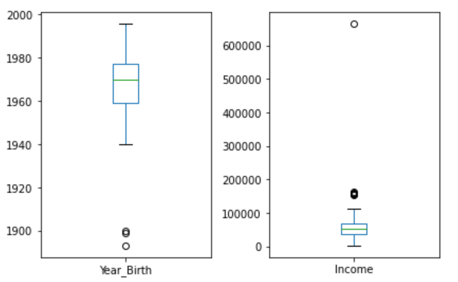
Step 2
Data Cleaning
Dropped unnecessary columns
Dropped rows with inefficient data
Adding new column to existing dataframe
Renaming columns
Transform string (currency) column to numeric (float)
Filled NAN values with the mean value of the column
Checked for outliers

Slide 5
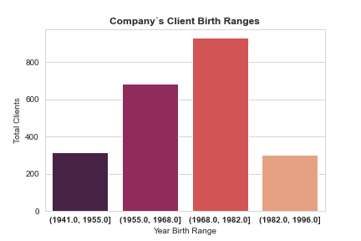
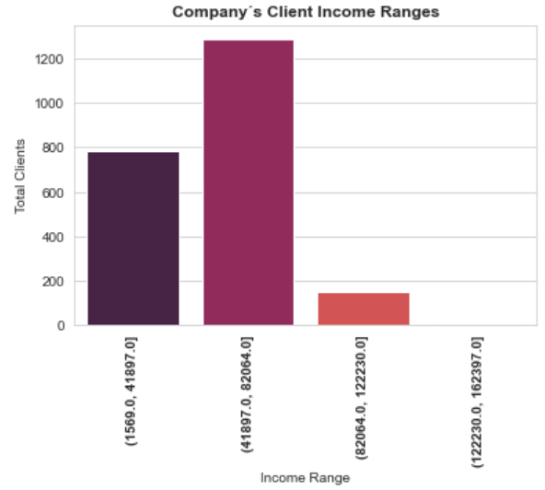
Step 3
Data Visualization

Slide 6
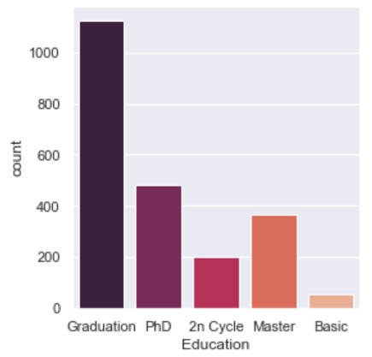
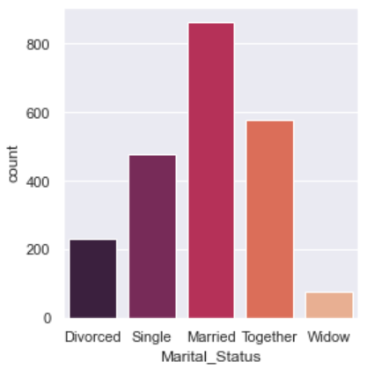
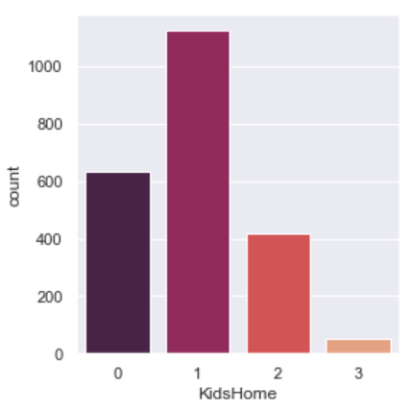
Step 3
Data Visualization

Slide 7
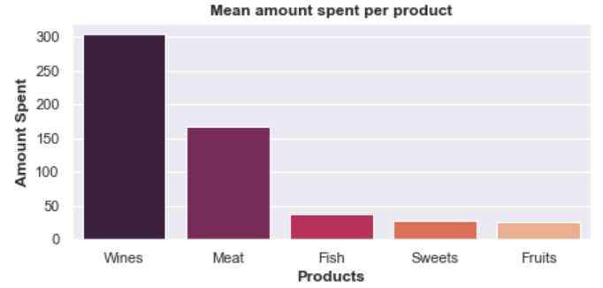
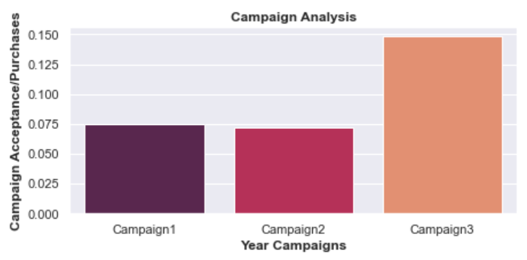
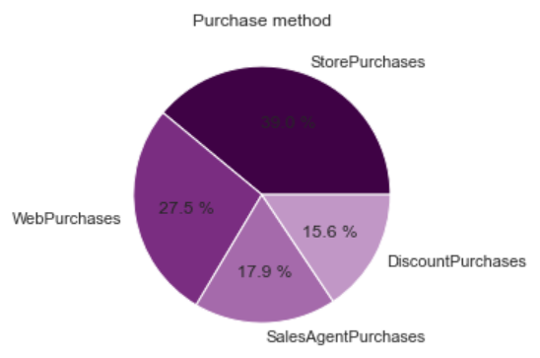
Step 3
Data Visualization

Slide 8
Step 4
Data Preprocessing
Encoding columns: “Education” and “Marital_Status” with Get_Dummies
Preparing input and target values:
X = Input data
Y = Target (Campaign 3)
Split data into train and test

Slide 9
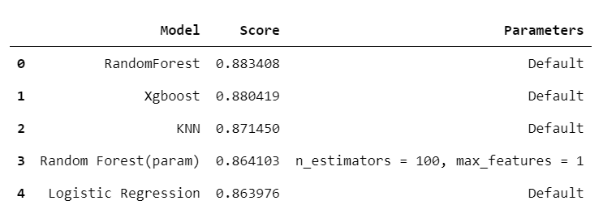
Step 5
Machine Learning
The objective of this Project is to predict if a campaign Will be accepted (purchase Will be made) by a customer.
Machine Learning algorithms used: CLASSIFICATION MODELS.
All models were trained with default parameters and with GridSearch (seperately)
Algorithms used:
Logistic Regression
SVC
Random Forest Classifier
KNN
XGBoost

Slide 10
Step 6
API Server
Saved the model with the best score (RandomForest)
Created arrays for columns where get dummies was done
Transformed these arrays into jsons
Imported jsons in my server
Step 1
Step 2
Step 3
Step 4
Pass this data to my model and show prediction
Created Html file to introduce the data
Step 6
Step 5

Slide 11
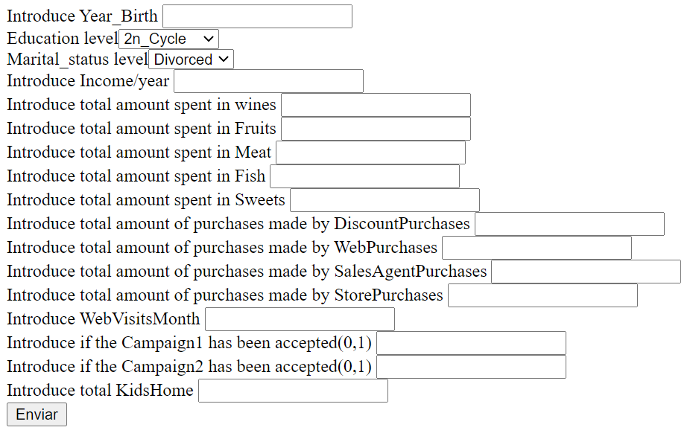

Slide 12
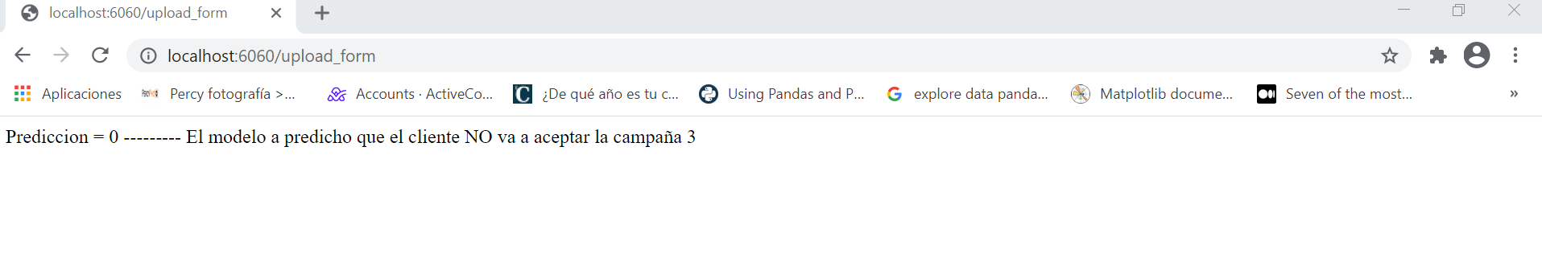
Prediction

Slide 13
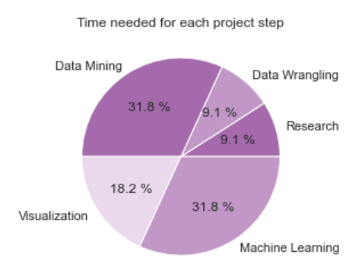
Project timings

Slide 14
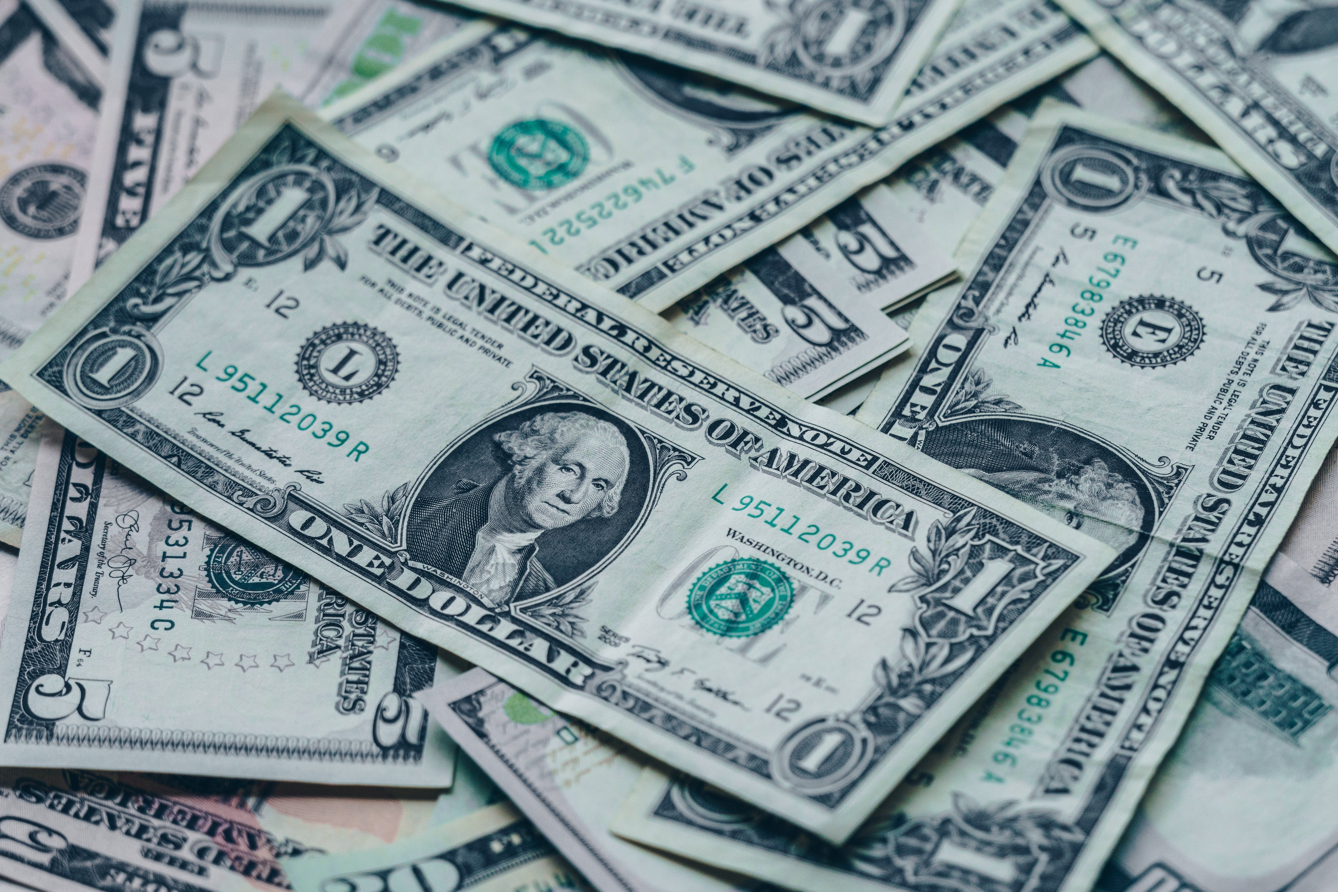
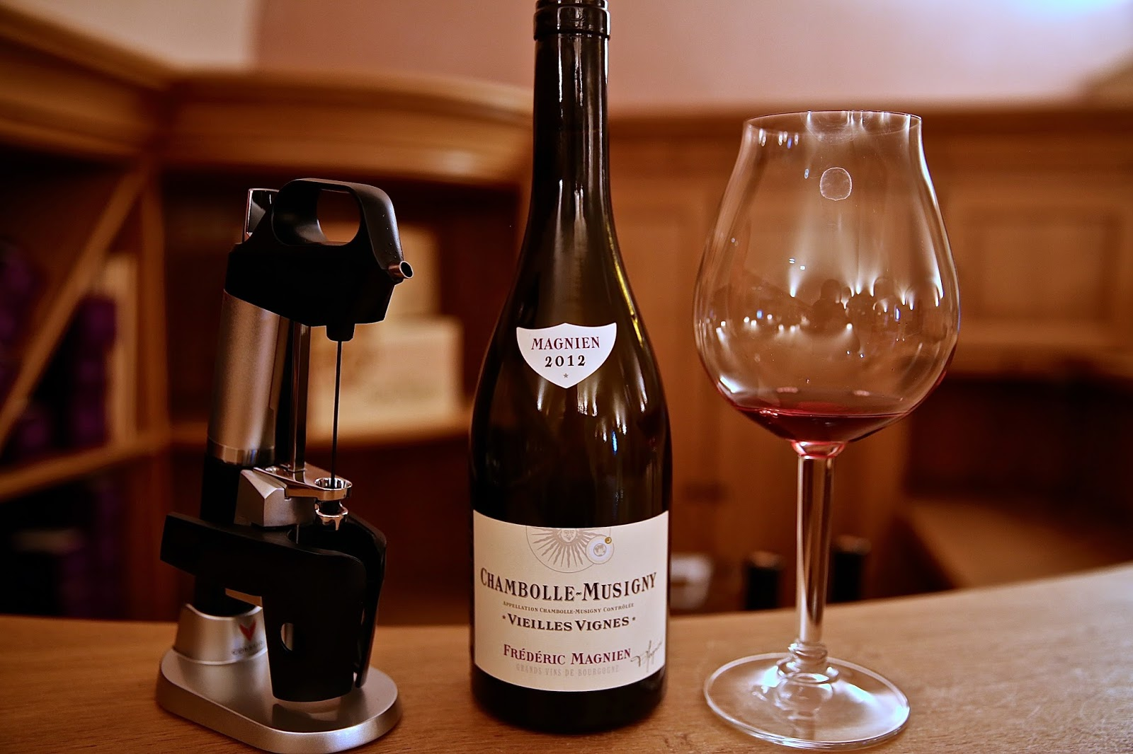
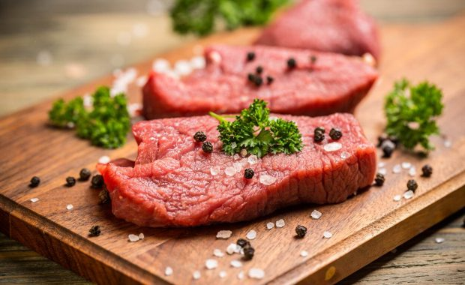



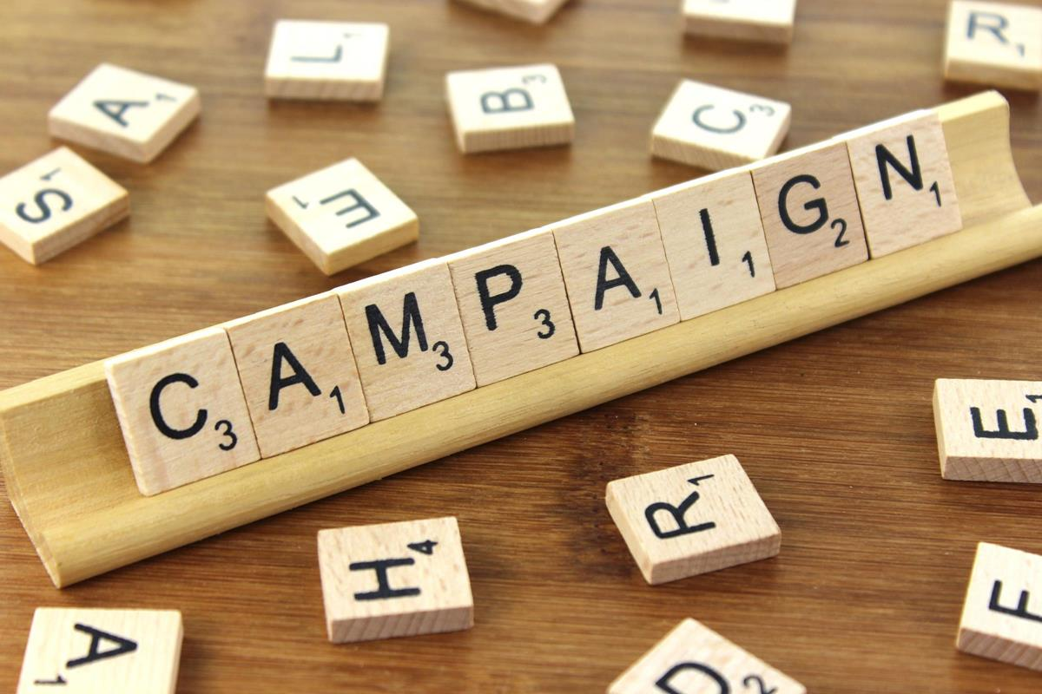

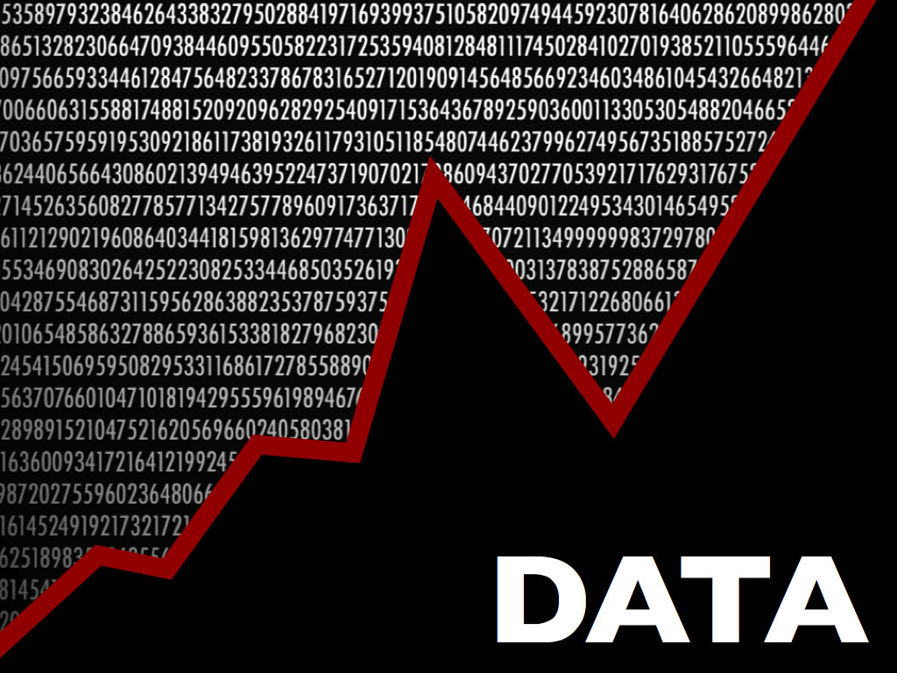

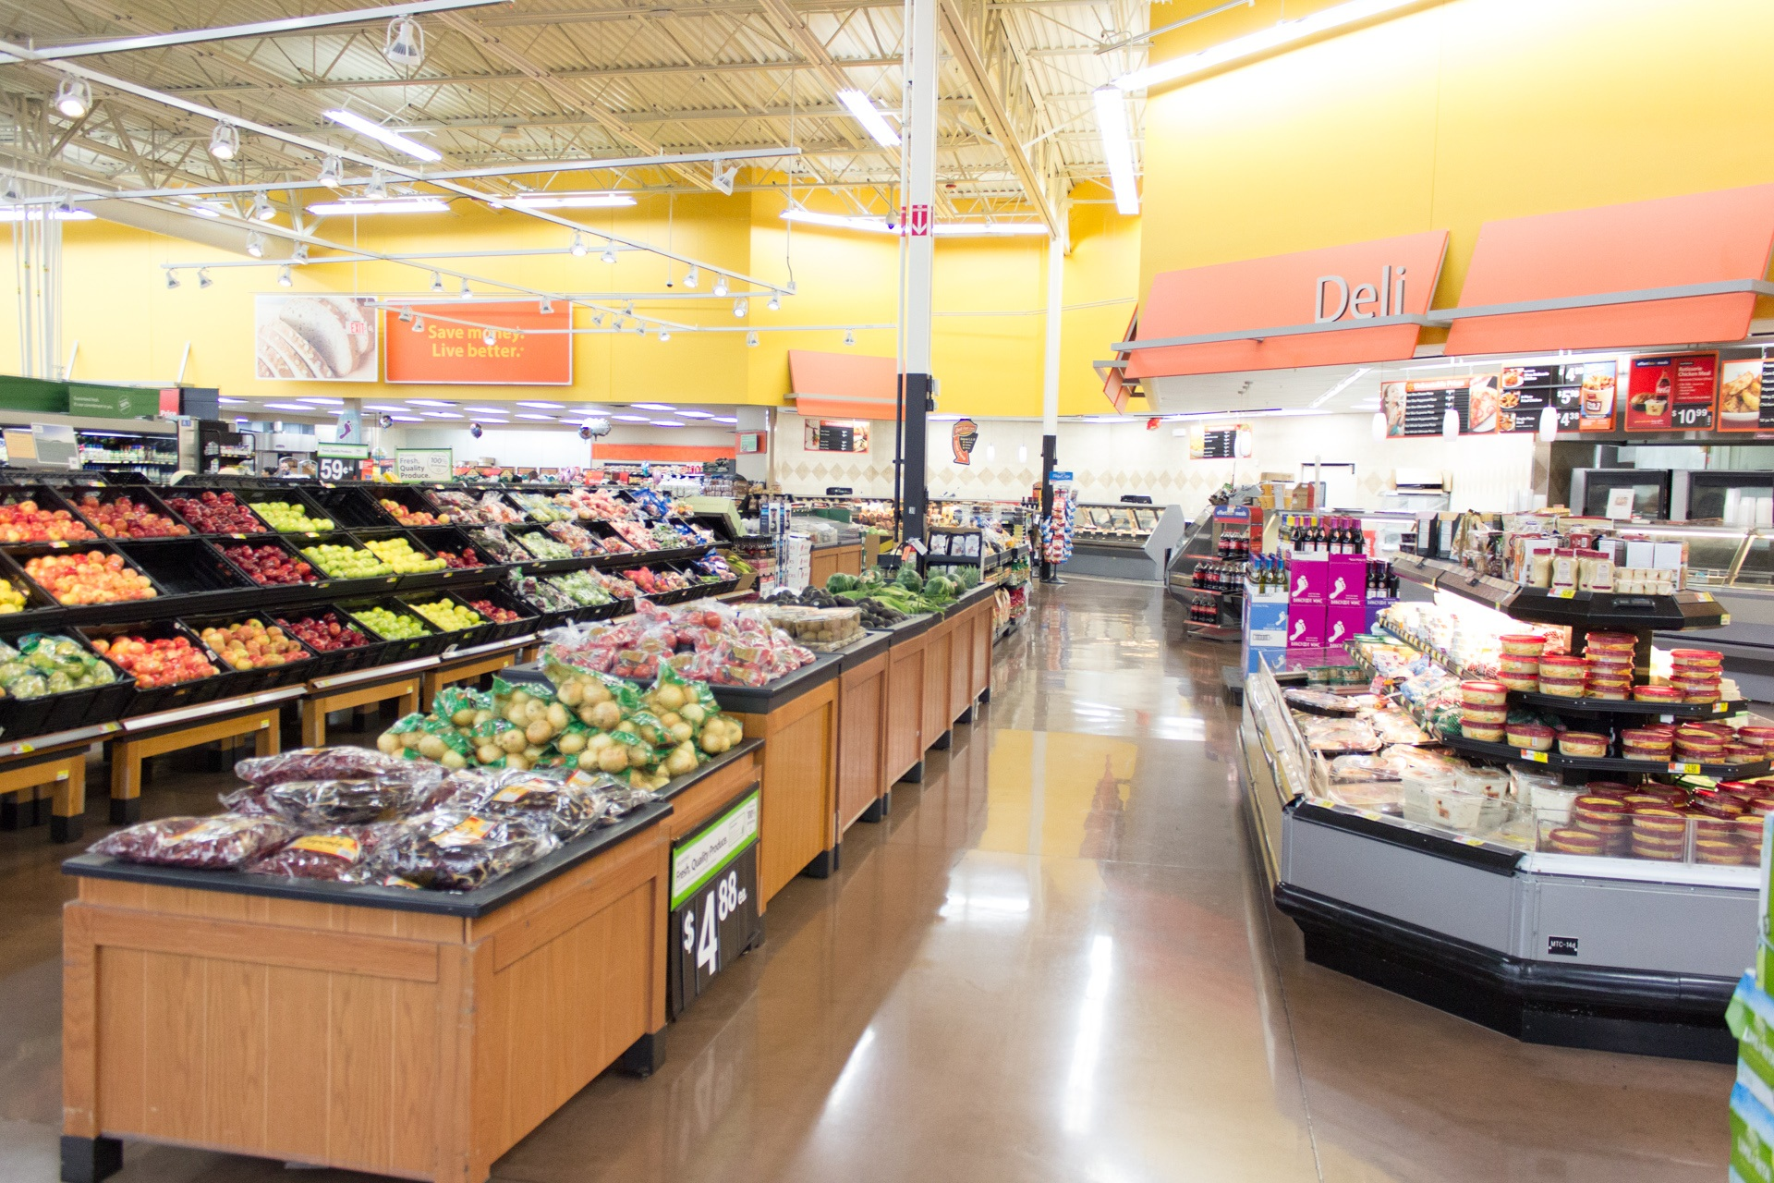
Conclusions
It´s possible to train a model that offers over 80% success in predictions over department store´s marketing campaigns
Client´s Income value is highly correlated with wines and meat purchases
There is no clear correlation between clients accepting campaign 3 and other variables
Wine purchases are highly correlated with SalesAgentPurchases and StorePurchases
Esta foto de Autor desconocido está bajo licencia CC BY-SA
Esta foto de Autor desconocido está bajo licencia CC BY

Slide 15

Future Steps
Find more information related to further analyse possible targets for marketing campaigns
Apply Deep Learning Algorithms
Data Augmentation
Feature engineering

Slide 16



Thank You!
kdadlani85@gmail.com
/kapil-dadlani-mirpuri
@KapilDM

